Slide 1
DigiRights
Belgium
Preliminary findings
Leuven, 30 March
Michele Panzavolta

Slide 2
BELGIUM
No general concept of digitalisation
No general rule on digital rights application
Participation via video-link possible for witnesses (mostly in situations of vulnerability)
No general rule on participation via video-link by defendant/suspect
  For trial
  For hearings in investigations (pre-trial custody, end of judicial investigations)

Slide 3
Presence at hearings
Ongoing debate on possibility to introduce participation from a distance
  Statute on participation of suspect via video-link in pre-trial custody procedures (Law 29 January 2016): judge decides if proceedings via videoconference
  Strong criticism by lawyers
  Quashed by decision of Constitutional Court 76/2018
    Violation of the principle of legality and foreseeability in procedural matters (decision solely left to discretion judge)
Relevant difference: presence of suspects in pre-trial proceedings (like pre-trial custody) not absolute right (different from right to be present at trial)

Slide 4
Covid-19 times
Covid experience
  Ministerial decisions (KB’s) no. 2 and no. 3 of 2020
    Possibility to adopt special measures to protect health and security
    Forms of participation via video-link foreseen but ultimately left to decisions of different courts (need to look into different practices)
    Possibility to suspend hearing for confidential consultation with client
  Const. Court 32/2021: suspension of right to be present at the hearing on internment too far-reaching
    Less restrictive measures possible (such as videoconference)
Notes:
KB nr. 2 of 9 April 2020

Slide 5
Vulnerable subjects
Explicit and specific rules for children
  Art. 30 section 2 Vlaamse jeugddelinquentiedecreet
    ‘The minor appears before the Tribunal in person, but upon consultation with his counsel he can explicit choose to appear via videoconference, if this possibility exists’
    But the judge can in any case order the physical presence
    Detailed guidelines on video-hearing in the Decision of Flemish Government of 23 October 2020
      All parties must be able to see each other without technical difficulties
      Suspect/defendant has at all times right to confidential consultation with counsel
      Possibility must exist to exchange digital documents
      Right that videoconference not stored

Slide 6
Other rights
  Right to legal assistance
    Digital equivalents?
    Law does not entirely clarify issue – scant provisions on telephonic consultations
      art. 2bis of the law on pre-trial custody (20.7.1990) states: a) consultation with client before interrogation of suspect in custody could take place via telephone, but only with the client’s consent; b) if appointed lawyer not present after two hours, the suspect has a telephonic consultation with a duty counsel
      Waiver of counsel only after (at least) telephonic consultation
      case-law discusses equivalence/possibility of telephone consultation with clients before interrogation
    Covid experience of interrogation with counsel from a distance to be checked

Slide 7
Right to translation and interpretation
  Right to translation and interpretation
    Digital equivalents?
    No explicit provision in the law
      Despite express provision in art. 2/6 Directive
    In practice possible to have interpreter intervene via telephone or video-link (Bockstaele, Verhoren)
    Contrary to other countries, use of videoconferences still underdeveloped (still in children’s shoes, “nog in de kinderschoenen”, Vanden Bosch)
      Only small projects – and still controversial
      2002 project between Charleroi and Leuven – stopped because no legal basis present

Slide 8
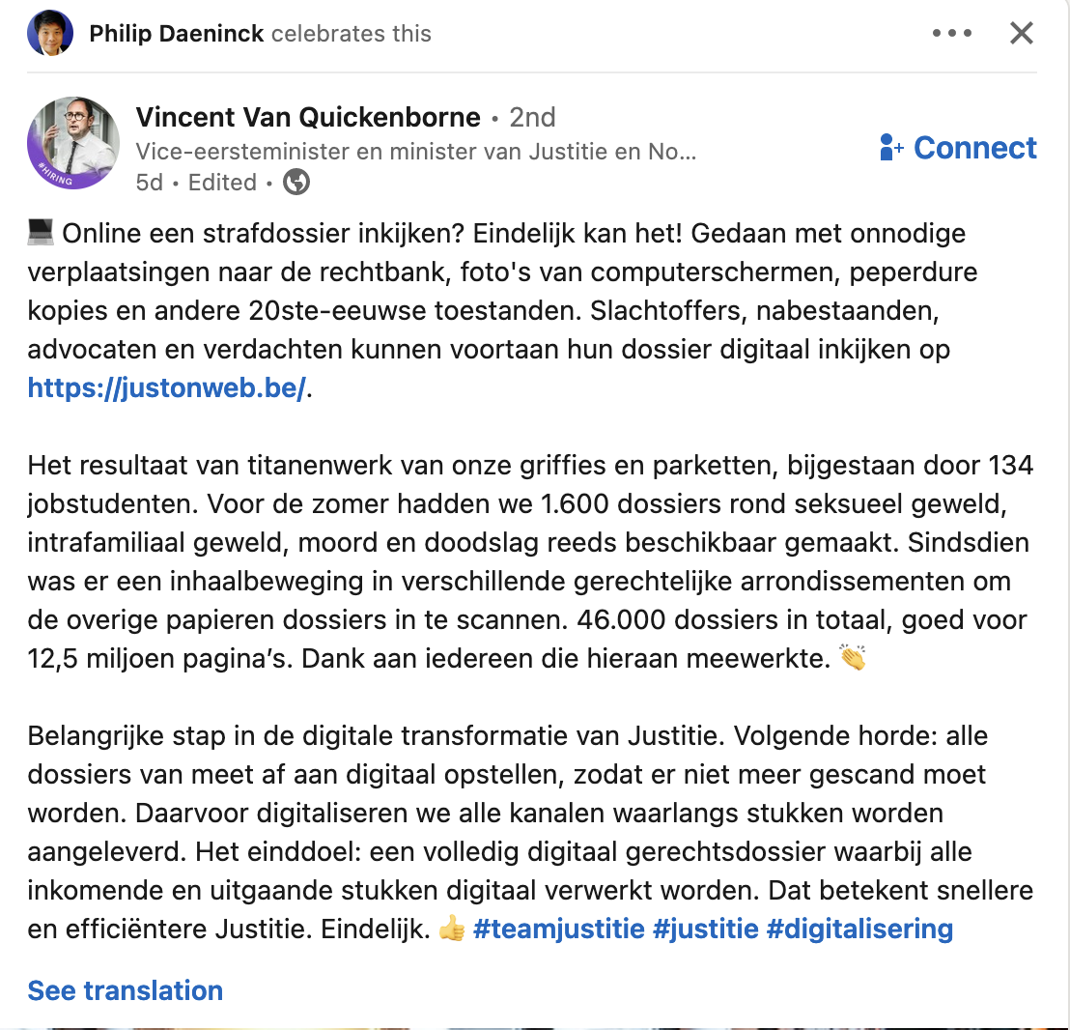
Access to file
Other digital application of rights
  Right to access to file
    No explicit mention in law of digital file and digital access
    Work on practical level
    https://justonweb.be/log-in
    E-dossier currently available for correctional tribunal – in the making for police tribunals

Slide 9
De iure condendo
New bill on participation from a distance approved by Council of Ministers on 23 December 2022
Voorontwerp van wet houdende organisatie van zittingen per videoconferentie in het kader van gerechtelijke procedures
    Considering CEPEJ Guidelines on videoconferencing in judicial proceedings
Consent as founding element – “of the interested person(s)”
  Right to veto digital hearings
    Except for pandemic situations or cases of real and concrete danger for the public security
Notes:
De criteria die de rechter bij zijn beslissing moet hanteren, zijn te vinden in de memorie van toelichting (pg. ):
• de duur van de procedure;
• het aantal procespartijen;
• de mogelijkheid tot interactie tussen de partijen;
• de fase van de procedure;
• de mogelijkheden van rechtsmiddelen;
• de specifieke complexiteit van de zaak;
• de hoedanigheid en de persoonlijke (fysieke of psychische) toestand van de personen die moeten worden
gehoord;
• de aard van het geschil;
• de hoeveelheid en de aard van de stukken die moet worden voorgelegd;
• elk ander element dat de rechter relevant acht.

Slide 10
De iure condendo (II)
Videoconferencing decided by judge on number of criteria
  Criteria to be considered
    Duration of proceedings
    Number of parties
    Stage of the proceedings
    Specific complexity of the case
    Possibility of interaction with parties
    Status and personal condition of the person(s) to be heard
    Nature of the case
    Existence of legal remedies
    Quantity and nature of evidentiary items
Technical elements to be further defined by Govt decisions
Notes:
De criteria die de rechter bij zijn beslissing moet hanteren, zijn te vinden in de memorie van toelichting (pg. ):
• de duur van de procedure;
• het aantal procespartijen;
• de mogelijkheid tot interactie tussen de partijen;
• de fase van de procedure;
• de mogelijkheden van rechtsmiddelen;
• de specifieke complexiteit van de zaak;
• de hoedanigheid en de persoonlijke (fysieke of psychische) toestand van de personen die moeten worden
gehoord;
• de aard van het geschil;
• de hoeveelheid en de aard van de stukken die moet worden voorgelegd;
• elk ander element dat de rechter relevant acht.

Slide 11
De iure condendo (III)
Bill 23 December 2023
  Also rules on remote interpretation via videoconference
  Interpreter can decide where to stay
    In court, where defendant is, remotely
Different for police interviews
  “telecommunication means”

Slide 12
De iure condendo (IV)
Points of discussion
  Impact on efficiency of justice and risk of dual tracks
  Asymmetry – some present, some not
  Scope of new rules – too broad? (all hearings)
  Exceptions to consent
  Lower income parties with limited access to digitalisation
  Technical safeguards

Slide 13
Thank you for your attention!

